Slide 1




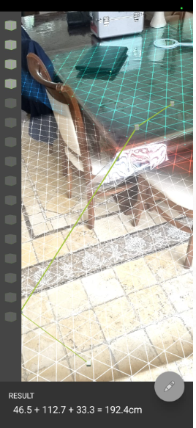
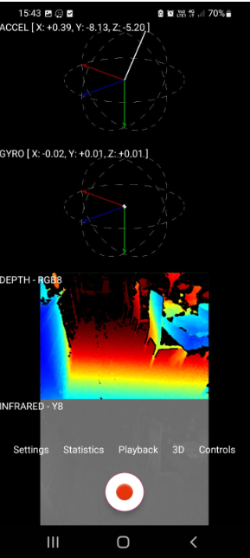


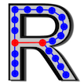




Autonomous Vehicle Elad Vaknin ,Afik Peretz, Avigael Abitbool Instructed by Professor Boaz Ben Moshe
31
Project goal :
The project is designed to develop a solution for navigation in autonomous vehicles (in a simulator or a real car), with an emphasis on the reliability of the autonomous software.
Introduction :
The world is progressing towards autonomous vehicles with autonomous control, one of the main systems required for the field is a reliable system that can scan its environment and give an accurate indication of when an accident danger occurs and prevent it by braking / acceleration.
For this to happen - the system needs to be sensitive and accurate and know how to scan the environment in real time and act accordingly - which is why we developed the tool we chose.
Methods/algorithms/Alternatives or Design Considerations :
A major part of this project and the solution we were required to perform was a comparison and literary scan between the two main cameras currently on the market: a camera with a depth dimension and a standard camera.
These cameras are used by the following tools: AR Core and Intel Real Sense.
This comparison is intended so that we can know who better uses the main mapping algorithm.
The main algorithm used in the system is the SLAM algorithm - which knows according to mathematical calculations to map three-dimensional spaces and reach very high accuracy.
Selected Approach :
Using the Intel Real Sense camera,
And using the AR Core app we photographed selected spaces to produce portfolio files suitable for use with the designed tool.
We created a cloud of dots and used
In the SLAM algorithm in order to map the space and thus a three-dimensional space is obtained with the help of which the vehicle knows how to navigate and identify the space and move according to the resulting scan
Visit Us

